Slide 1
Machine-Independent Optimization

Slide 2
Outline
Machine-Independent Optimization
  Code motion
  Memory optimization
Optimizing Blockers
  Memory alias
  Side effect in function call
Suggested reading
  5.3，5.2，5.4 ~ 5.6, 5.1

Slide 3
Motivation
Constant factors matter too!
  easily see 10:1 performance range depending on how code is written
  must optimize at multiple levels
    algorithm, data representations, procedures, and loops

Slide 4
Motivation
Understand system to optimize performance
  how programs are compiled and executed
  how to measure program performance and identify bottlenecks
  how to improve performance without destroying code modularity and generality

Slide 5
Time Scales
Absolute Time
  Typically use nanoseconds: 10^{–9} seconds
  Time scale of computer instructions
Clock Cycles
  Typical Range
    100 MHz
      10⁸ cycles per second, clock period = 10ns
    2 GHz
      2 X 10⁹ cycles per second, clock period = 0.5ns

Slide 6
Cycles Per Element
Convenient way to express performance of program that operators on vectors or lists
Length = n
T = CPE*n + Overhead

Slide 7
CPE
1 void psum1(float a[], float p[], long int n)
2 {
3 long int i;
4
5 p[0] = a[0] ;
6 for (i = 1; i < n; i++)
7 p[i] = p[i-1] + a[i];
8 }
9

Slide 8
CPE
10 void psum2(float a[], float p[]; long int n)
11 {
12 long int i;
13 p[0] = a[0] ;
14 for (i = 1; i < n-1; i+=2) {
15 float mid_val = p[i-1] + a[i] ;
16 p[i] = mid_val ;
17 p[i+1] = mid_val + a[i+1];
18 }
/* For odd n, finish remaining element */
if ( i < n )
p[i] = p[i-1] + a[i] ;
}

Slide 9
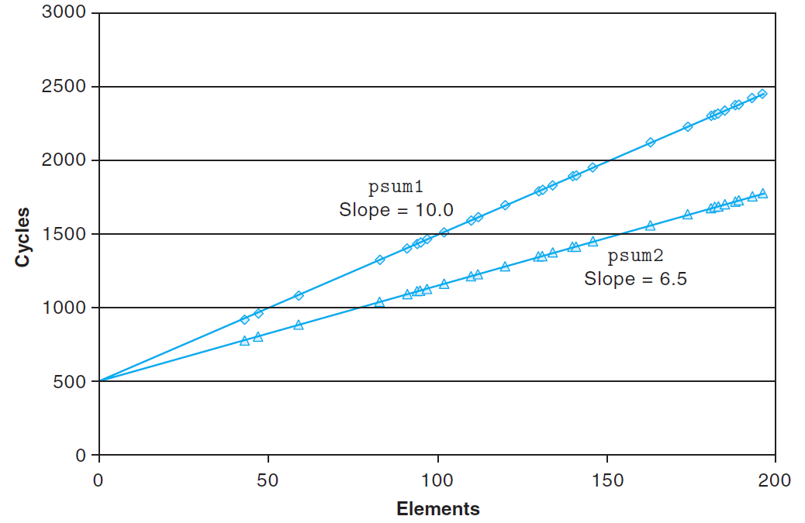
Cycles Per Element

Slide 10
Vector ADT
length
0
1
2
length–1
data
• • •
typedef struct {
int len ;
data_t *data ;
} vec_rec, *vec_ptr ;
typedef int data_t ;

Slide 11
Procedures
vec_ptr new_vec(int len)
  Create vector of specified length
int vec_length(vec_ptr)
  Return length of vector
data_t *get_vec_start(vec_ptr v)
  Return pointer to start of vector data
int get_vec_element(vec_ptr v, int index, int *dest)
  Retrieve vector element, store at *dest
  Return 0 if out of bounds, 1 if successful
Similar to array implementations in Pascal, Java
  E.g., always do bounds checking

Slide 12
Vector ADT
vec_ptr new_vec(int len)
{
/* allocate header structure */
vec_ptr result = (vec_ptr) malloc(sizeof(vec_rec)) ;
if ( !result )
return NULL ;
result->len = len ;

Slide 13
Vector ADT
/* allocate array */
if ( len > 0 ) {
data_t *data = (data_t *)calloc(len, sizeof(data_t)) ;
if ( !data ) {
free( (void *)result ) ;
return NULL ; /* couldn’t allocte stroage */
}
result->data = data
} else
result->data = NULL
return result ;
}

Slide 14
Vector ADT
/*
* Retrieve vector element and store at dest.
* Return 0 (out of bounds) or 1 (successful)
*/
int get_vec_element(vec_ptr v, int index, data_t *dest)
{
if ( index < 0 || index >= v->len)
return 0 ;
*dest = v->data[index] ;
return 1;
}

Slide 15
Vector ADT
/* Return length of vector */
int vec_length(vec_ptr)
{
return v->len ;
}
/* Return pointer to start of vector data */
data_t *get_vec_start(vec_ptr v)
{
return v->data ;
}

Slide 16
Optimization Example
#ifdef ADD
#define IDENT 0
#define OP +
typedef int data_t;
#else
#define IDENT 1
#define OP *
typedef double data_t
#endif

Slide 17
Optimization Example
void combine1(vec_ptr v, data_t *dest)
{
long int i;
*dest = IDENT;
for (i = 0; i < vec_length(v); i++) {
data_t val;
get_vec_element(v, i, &val);
*dest = *dest OP val;
}
}
Compute sum (product) of all elements of vector
Store result at destination location

Slide 18
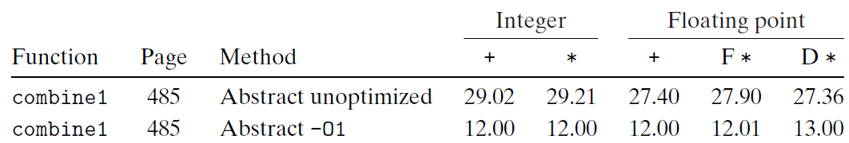
Time Scales

Slide 19
Understanding Loop
void combine1(vec_ptr v, data_t *dest)
{
long int i;
*dest = IDENT;
for (i = 0; i < vec_length(v); i++) {
data_t val;
get_vec_element(v, i, &val);
*dest = *dest OP val;
}
}

Slide 20
Understanding Loop
void combine1-goto(vec_ptr v, data_t *dest)
{
long int i = 0;
data_t val;
*dest = 0;
if (i >= vec_length(v))
goto done;
loop:
get_vec_element(v, i, &val);
*dest += val;
i++;
if (i < vec_length(v))
goto loop
done:
}
Procedure vec_length called every iteration
Even though result always the same
1 iteration

Slide 21
Code Motion
void combine2(vec_ptr v, data_t *dest)
{
long int i;
long int length = vec_length(v);
*dest = IDENT;
for (i = 0; i < length; i++) {
data_t val;
get_vec_element(v, i, &val);
*dest = *dest OP val;
}
}

Slide 22
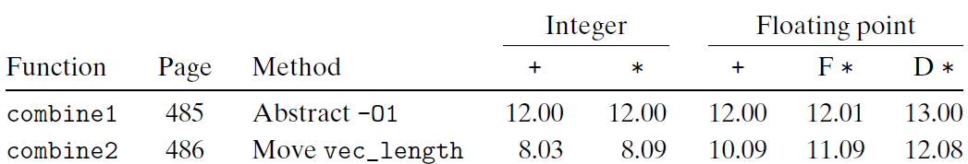
Code Motion
Optimization
  Move call to vec_length out of inner loop
    Value does not change from one iteration to next
    Code motion

Slide 23
Code Motion
1 /* Convert string to lowercase: slow */
2 void lower1(char *s)
3 {
4 int i;
5
6 for (i = 0; i < strlen(s); i++)
7 if (s[i] >= ’A’ && s[i] <= ’Z’)
8 s[i] -= (’A’ - ’a’);
9 }
10

Slide 24
Code Motion
11 /* Convert string to lowercase: faster */
12 void lower2(char *s)
13 {
14 int i;
15 int len = strlen(s);
16
17 for (i = 0; i < len; i++)
18 if (s[i] >= ’A’ && s[i] <= ’Z’)
19 s[i] -= (’A’ - ’a’);
20 }
21

Slide 25
Code Motion
22 /* Sample implementation of library function strlen */
23 /* Compute length of string */
24 size_t strlen(const char *s)
25 {
26 int length = 0;
27 while (*s != ’\0’) {
28 s++;
29 length++;
30 }
31 return length;
32 }

Slide 26
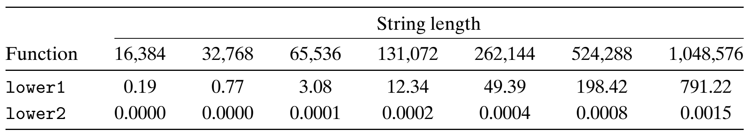
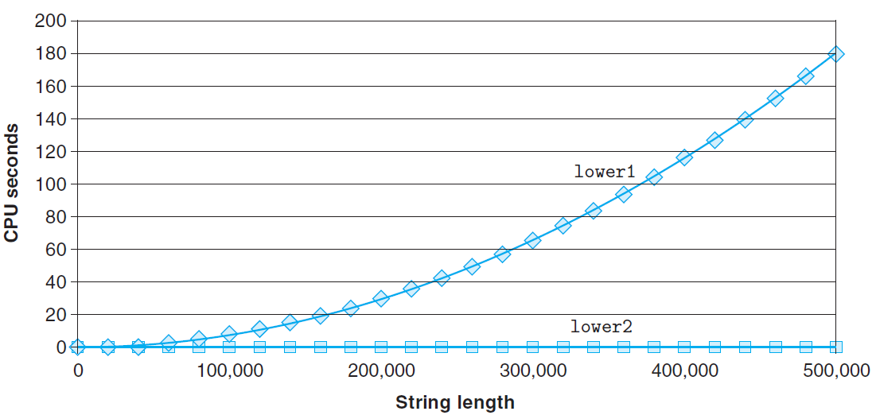
Code Motion

Slide 27
Reduction in Strength
void combine3(vec_ptr v, data_t *dest)
{
long int i;
long int length = vec_length(v);
data_t *data = get_vec_start(v);
*dest = IDENT;
for ( i = 0 ; i < length ; i++ ) {
*dest = *dest OP data[i] ;
}

Slide 28
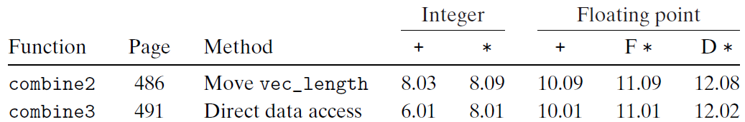
Reduction in Strength
Optimization
  Avoid procedure call to retrieve each vector element
    Get pointer to start of array before loop
    Within loop just do pointer reference
    Not as clean in terms of data abstraction

Slide 29
Eliminate Unneeded Memory References
combine3: data_t = float, OP = *
i in %rdx, data in %rax, dest in %rbp
1 .L498: loop:
2 movss (%rbp), %xmm0 Read product from dest
3 mulss (%rax,%rdx,4), %xmm0 Multiply product by data[i]
4 movss %xmm0, (%rbp) Store product at dest
5 addq $1, %rdx Increment i
6 cmpq %rdx, %r12 Compare i:limit
7 jg .L498 If >, goto loop

Slide 30
Eliminate Unneeded Memory References
void combine4(vec_ptr v, data_t *dest)
{
long int i;
long int length = vec_length(v);
data_t *data = get_vec_start(v);
data_t acc = IDENT;
for (i = 0; i < length; i++)
acc = acc OP data[i];
*dest = acc;
}

Slide 31
Eliminate Unneeded Memory References
combine4: data_t = float, OP = *
i in %rdx, data in %rax, limit in %rbp, acc in %xmm0
1 .L488: loop:
2 mulss (%rax,%rdx,4), %xmm0 Multiply acc by data[i]
3 addq $1, %rdx Increment i
4 cmpq %rdx, %rbp Compare limit:i
5 jg .L488 If >, goto loop

Slide 32
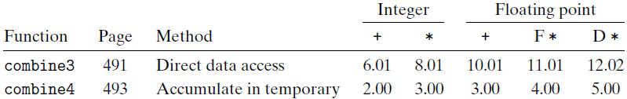
Eliminate Unneeded Memory References
Optimization
  Don’t need to store in destination until end
  Local variable sum held in register
  Avoids 1 memory read, 1 memory write per cycle

Slide 33
Machine Independent Opt. Results
Optimizations
  Reduce function calls and memory references within loop

Slide 34
Optimizing Compilers
Provide efficient mapping of program to machine
  register allocation
  code selection and ordering
  eliminating minor inefficiencies

Slide 35
Optimizing Compilers
Don’t (usually) improve asymptotic efficiency
  up to programmer to select best overall algorithm
  big-O savings are (often) more important than constant factors
    but constant factors also matter
Have difficulty overcoming “optimization blockers”
  potential memory aliasing
  potential procedure side-effects

Slide 36
Optimization Blockers ⎯ Memory aliasing
void twiddle1(int *xp, int *yp)
  {
  *xp += *yp ;
  *xp += *yp ;
  }
  void twiddle2(int *xp, int *yp)
  {
  *xp += 2* *yp ;
  }

Slide 37
Optimization Blockers ⎯ Function call and side effect
int f(int) ;
int func1(x)
{
return f(x)+f(x)+f(x)+f(x) ;
}
int func2(x)
{
return 4*f(x) ;
}

Slide 38
Optimization Blockers ⎯ Function call and side effect
int counter = 0 ;
int f(int x)
{
return counter++ ;
}

Slide 39
Optimization Blocker: Memory Aliasing
Aliasing
  Two different memory references specify single location
Example
  v: [2, 3, 5]
  combine3(v, get_vec_start(v)+2) --> ?
  combine4(v, get_vec_start(v)+2) --> ?
Function | Intial | Before loop | i=0 | i=1 | i=2 | Final
Combine3 | [2,3,5] | [2,3,1] | [2,3,2] | [2,3,6] | [2,3,36] | [2,3,36]
combine4 | [2,3,5] | [2,3,5] | [2,3,5] | [2,3,5] | [2,3,5] | [2,3,30]

Slide 40
Optimization Blocker: Memory Aliasing
Observations
  Easy to have happen in C
    Since allowed to do address arithmetic
    Direct access to storage structures
  Get in habit of introducing local variables
    Accumulating within loops
    Your way of telling compiler not to check for aliasing

Slide 41
Limitations of Optimizing Compilers
Operate Under Fundamental Constraint
  Must not cause any change in program behavior under any possible condition
  Often prevents it from making optimizations when would only affect behavior under pathological conditions.

Slide 42
Limitations of Optimizing Compilers
Behavior that may be obvious to the programmer can be obfuscated by languages and coding styles
  e.g., data ranges may be more limited than variable types suggest
    e.g., using an “int” in C for what could be an enumerated type
When in doubt, the compiler must be conservative

Slide 43
Example
void combine1(vec_ptr v, data_t *dest)
{
long int i;
*dest = IDENT;
for (i = 0; i < vec_length(v); i++) {
data_t val;
get_vec_element(v, i, &val);
*dest = *dest OP val;
}
}

Slide 44
Example
void combine2(vec_ptr v, data_t *dest)
{
long int i;
long int length = vec_length(v);
*dest = IDENT;
for (i = 0; i < length; i++) {
data_t val;
get_vec_element(v, i, &val);
*dest = *dest OP val;
}
}

Slide 45
Example
void combine3(vec_ptr v, data_t *dest)
{
long int i;
long int length = vec_length(v);
data_t *data = get_vec_start(v);
*dest = IDENT;
for (i = 0; i < length; i++) {
*dest = *dest OP data[i];
}

Slide 46
Example
void combine4(vec_ptr v, data_t *dest)
{
long int i;
long int length = vec_length(v);
data_t *data = get_vec_start(v);
data_t x = IDENT;
for (i = 0; i < length; i++)
x = x OP data[i];
*dest = x;
}

Slide 47
Effectiveness of the Optimization
 |  |  |  | Integer |  |  | Floating point
Function |  | Method |  | + | * |  | + | F* | D*
combine 1 |  | Abstract -O1 |  | 12.00 | 12.00 |  | 12.00 | 12.00 | 12.00
combine 4 |  | Accumulate in temporary |  | 2.00 | 3.00 |  | 3.00 | 4.00 | 5.00

